Slide 1
PREPARED FOR • Clario
Monthly Business Review
MBR
Sales, Consumption & Customer Feedback
Reporting Period
Wastage
Ordered/Consumption
Customer Feedback
June 2026
PREPARED BY
SMARTQ • F&B 360°

Slide 2
Billing & Consumption Overview
April – June 2026
Billing trend (₹ lakhs)
Avg daily orders vs actual consumption — June
TOTAL BILLING · JUNE
₹9.77L
▲ 29.5% vs May (₹7.55L)
AVG DAILY ORDERS · JUNE
133 / 125
Lunch / Dinner
KEY INSIGHTS
Total billing rose 29.5% to ₹9.77L in June from ₹7.55L in May — the strongest month in the Apr–June window, ahead of even April's ₹9.4L.
Actual consumption outpaced orders in both sessions this June — Lunch ran 133 ordered vs 143 consumed (+7.5%), Dinner 125 vs 132 (+5.6%) — consistent with the strong vegetarian fulfillment trend seen below.
Vegetarian meals are consistently under-forecast: daily fulfillment (actual ÷ ordered) hit as high as 127% for Lunch and 123% for Dinner this month, while non-vegetarian meals stayed accurately planned at ~100% throughout.
Clario · MBR June 2026
2

Slide 3
Order Placed vs Actual Consumption — Day-wise
June 2026 · Monday – Thursday (no Friday service)
Category | Mon Ord. | Mon Act. | Mon % | Tue Ord. | Tue Act. | Tue % | Wed Ord. | Wed Act. | Wed % | Thu Ord. | Thu Act. | Thu %
Lunch — Veg | 52 | 64 | 123% | 52 | 59 | 113% | 48 | 61 | 127% | 43 | 52 | 121%
Lunch — Non-Veg | 108 | 108 | 100% | 108 | 108 | 100% | 93 | 90 | 97% | 35 | 35 | 100%
Dinner — Veg | 48 | 59 | 123% | 50 | 51 | 102% | 50 | 58 | 116% | 46 | 56 | 122%
Dinner — Non-Veg | 78 | 78 | 100% | 102 | 102 | 100% | 103 | 103 | 100% | 35 | 35 | 100%
KEY INSIGHTS
Vegetarian Lunch consistently ran above plan all four days (113%–127%), peaking Wednesday at 127% (48 ordered vs 61 consumed) — the clearest, most persistent under-forecast in the month.
Vegetarian Dinner followed the same pattern, from 102% (Tuesday) to 123% (Monday) — every single day saw more veg meals consumed than ordered.
Non-Vegetarian Lunch and Dinner both tracked plan almost exactly (97%–100%) across all four days, confirming demand forecasting is accurate and stable for non-veg — the gap is isolated to vegetarian planning.
No Friday service was recorded this month; all figures reflect a Monday–Thursday operating week.
Clario · MBR June 2026
3

Slide 4
Bain-Marie Wastage
Top items — May vs June 2026 · Average wastage across all sessions: 2.9 kg
Lunch — wastage by item (kg)
Dinner — wastage by item (kg)
KEY INSIGHTS
Non-Veg Gravy/Biryani wastage rose in both sessions — Lunch from 0.25 kg to 0.44 kg and Dinner from near-zero to 0.13 kg — the clearest area to tighten portioning this month.
Indian Bread improved at Lunch (0.25 → 0.19 kg) but rose at Dinner (0.11 → 0.19 kg) — a mixed result rather than the across-the-board improvement noted in the original report; Dinner bread planning needs a closer look.
White Rice moved in opposite directions by session — Lunch wastage edged up (0.64 → 0.67 kg) while Dinner improved (0.82 → 0.72 kg) — both sessions are within a stable, low range.
Clario · MBR June 2026
4

Slide 5
Voice of Customer
Star rating distribution — April to June 2026
Rating distribution by month
5-STAR · JUNE
45%
▼ from 76% May was a peak month
1★ & 3★ COMBINED
18%
▲ from 6% vs May
KEY INSIGHTS
5-star ratings eased to 45% in June from a strong 76% in May, while 4-star grew to 36% — overall sentiment stayed positive, with 82% of feedback at 4 or 5 stars.
Combined 1★ and 3★ feedback rose to 18% in June from just 6% in May, reversing part of May's gain — worth a closer look at the specific comments behind this month's lower scores.
April's very small, heavily 1-star sample (67%) has fully recovered by May and June, confirming the underlying trend is a strong recovery with a modest June pullback rather than a sustained decline.
Clario · MBR June 2026
5

Slide 6
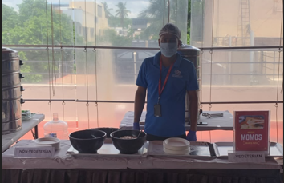
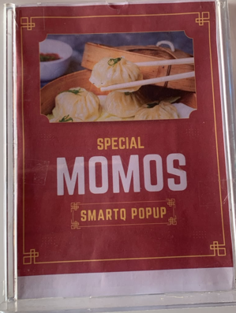
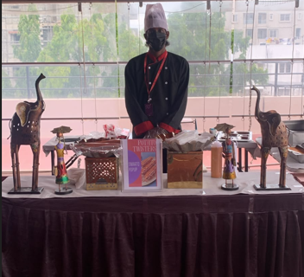
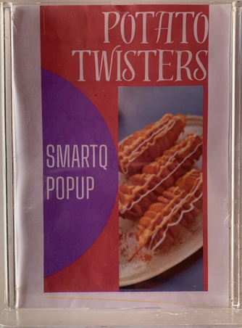
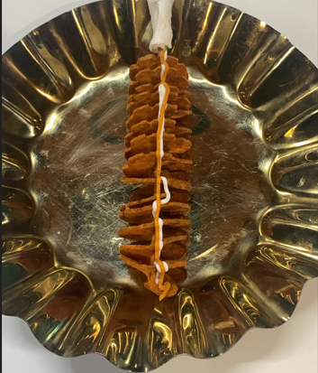
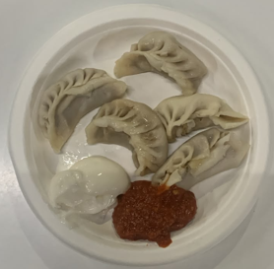
Pop-Up Highlights
June 2026
Date | Day | Site | Vendor | Meal Type | Menu
09-Jun-26 | Tuesday | Clario | Corporate Cafe | Pop-Up | Veg & Chicken Momos
30-Jun-26 | Tuesday | Clario | STM | Pop-Up | Potato Twister
Glimpses from this month's pop-up events
Clario · MBR June 2026
6

Slide 7
Hits & Misses
June 2026
HITS
MISSES
Special pop-ups this month — Veg & Chicken Momos and Potato Twisters — were well received.
Regular food, swab, and equipment lab tests continue to ensure quality and safety standards.
Menu enhancements introduced improved combinations for a better customer experience.
Kitchen audits and re-audits are conducted regularly to maintain consistent quality standards.
No misses recorded this period.
ONGOING FOCUS
Vendor collaboration continues, with feedback shared regularly to optimize product quality.
Clario · MBR June 2026
7

Slide 8
HSEQ & Vendor Performance
June 2026
Site audit score by section — June '26
TRAINING TOPICS — JUNE
High-risk vegetables handling
Personal hygiene and grooming
Jewelry policy
PPE usage
Slips, trips and work safety
KEY INSIGHTS
Overall vendor audit score came in at 81% for June, led by Environment Safety (88%) and Occupational Health & Safety (86%).
Facilities is the lowest-scoring section at 73% and the clearest opportunity area — this ties in with this month's PPE and safety-focused training topics.
The site & vendor audit runs quarterly; the next audit is scheduled for July 2026.
Clario · MBR June 2026
8

Slide 9
Incident Summary
SMARTQ
Trailing 15 months · April 2025 – June 2026
TOTAL INCIDENTS
INCIDENT LOG
2
Month | Category | Count
June 2025 | Insect | 1
April 2026 | Foreign Object (FO) | 1
over 15 months
JUNE 2026
No incidents were recorded in any other month across the 15-month window, including June 2026.
0
No incidents
KEY INSIGHTS
Only two incidents have been logged across the trailing 15 months — one insect-related (June 2025) and one foreign-object incident (April 2026) — both isolated, one-off events with no repeat occurrences.
Clario · MBR June 2026
9

Slide 10
Thank You

